Slide 1
2017 Annual Awards

Slide 2
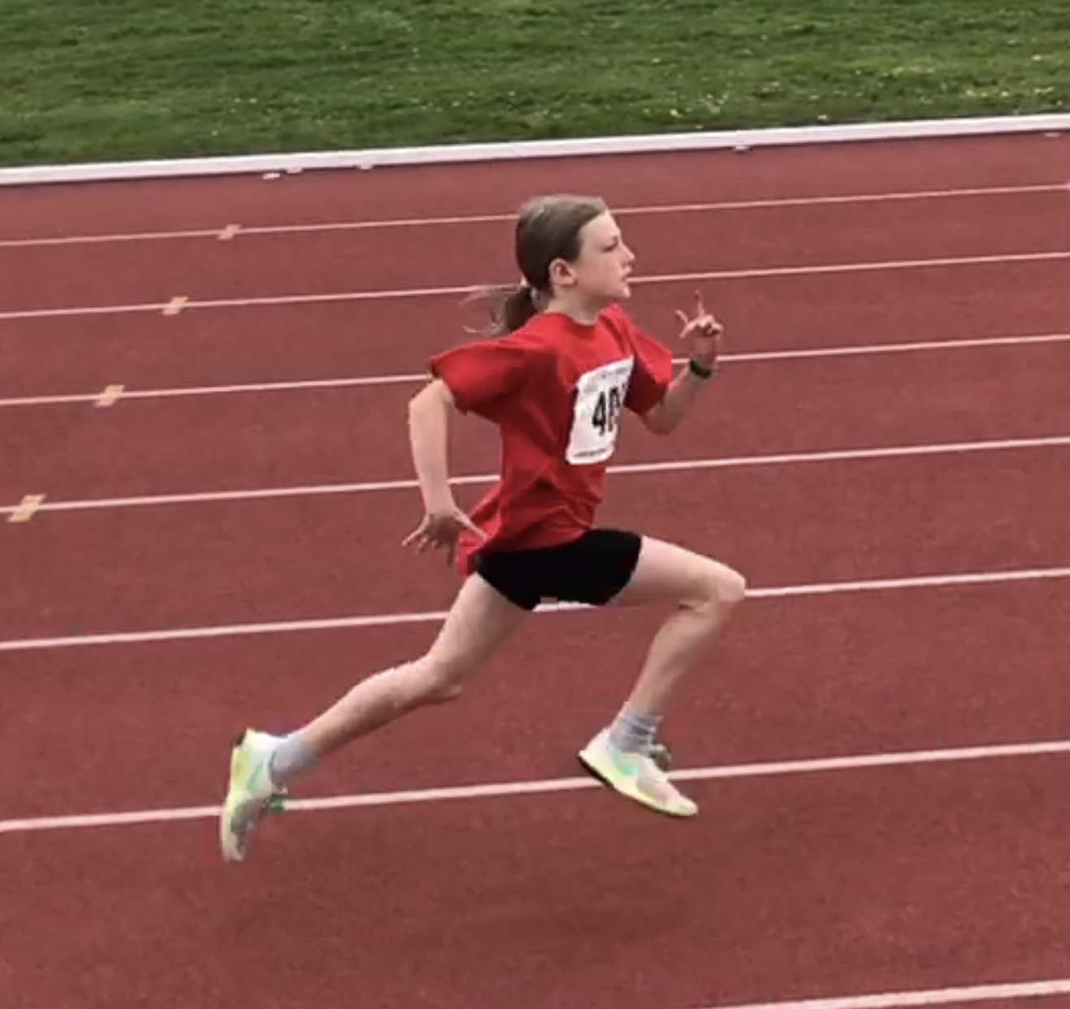
TOP 10 TYKE GIRLS
Cameryn Larre
Sadie Snyder
Split City Sonics
Andrea Jacob
Caltaf Athletic Association
Leduc Track and Field Club

Slide 3
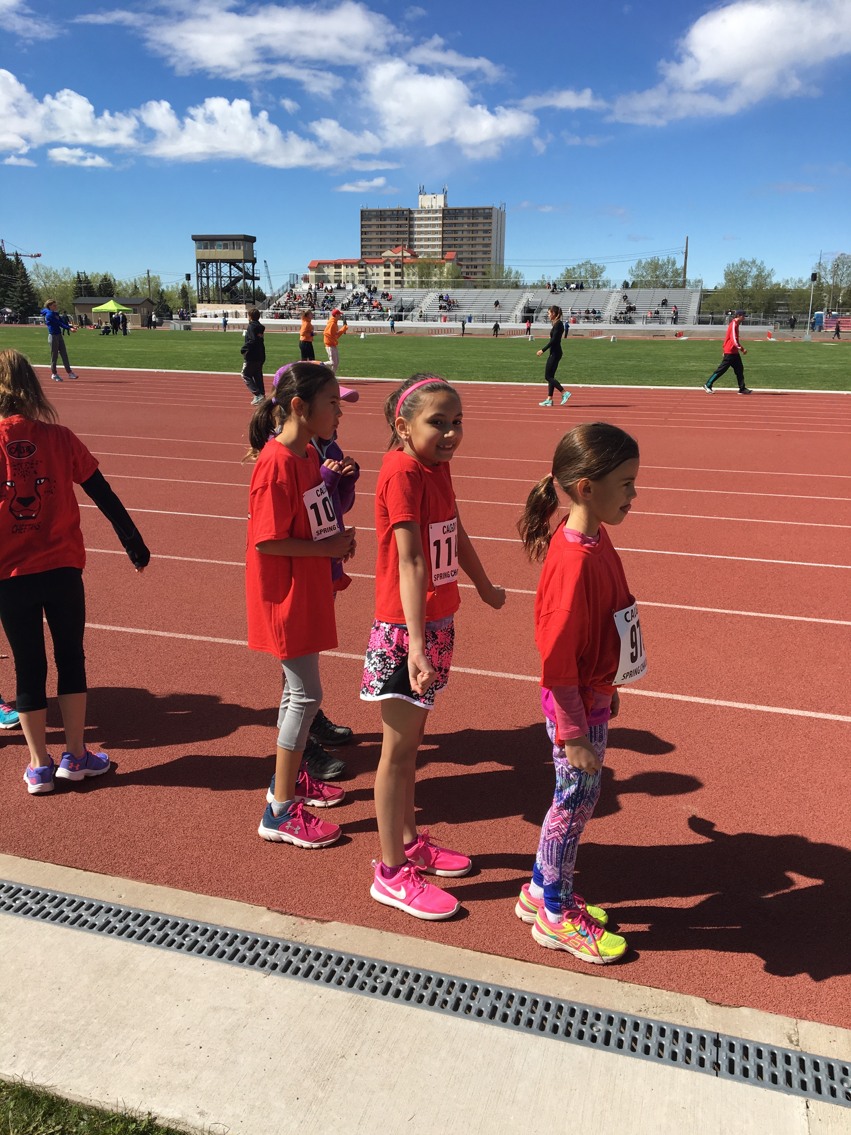
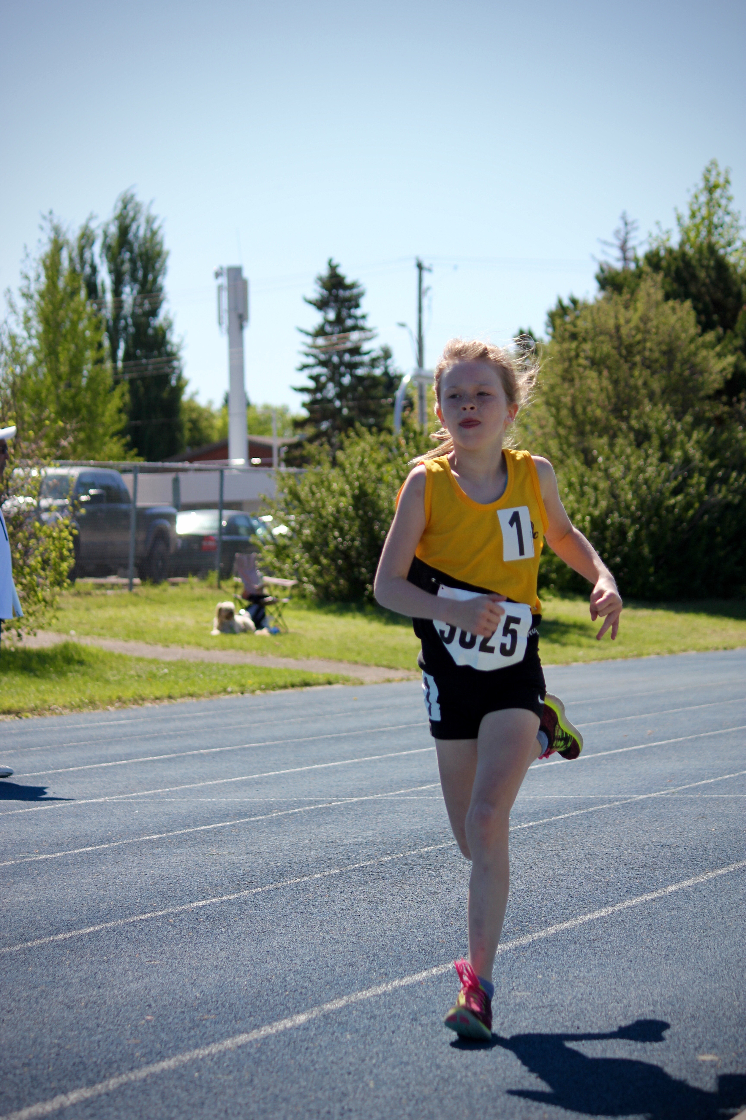
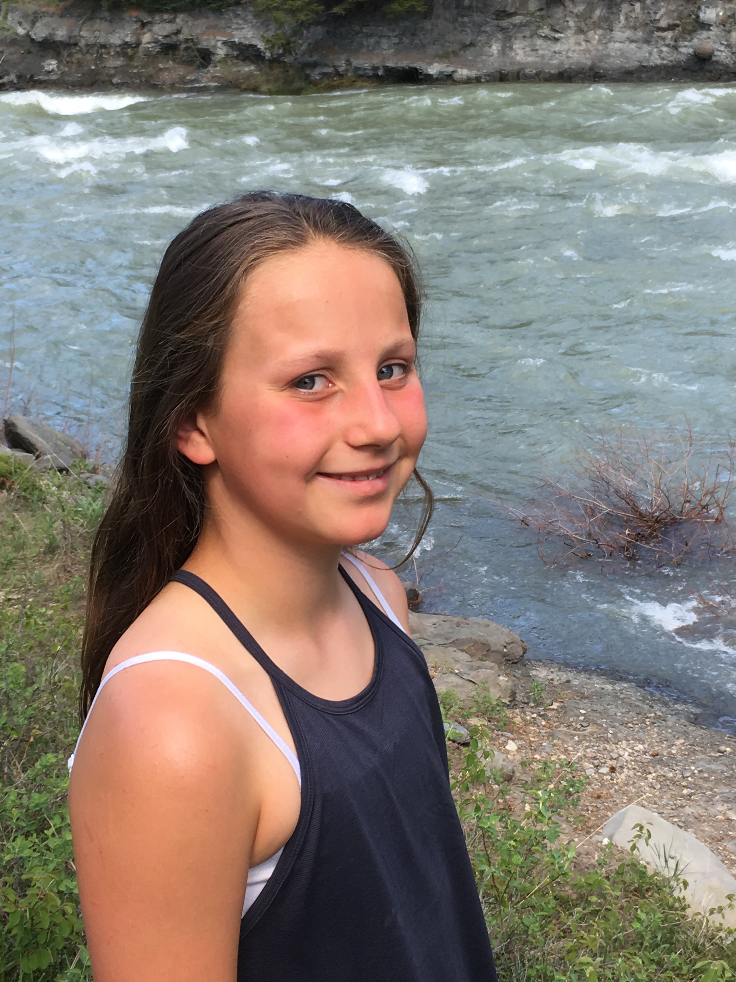
TOP 10 TYKE GIRLS
Neesha Walter
Aryonnah Knee
Naoise Gelber
Leduc Track and Field Club
Pass Trak
Caltaf Athletic Association

Slide 4
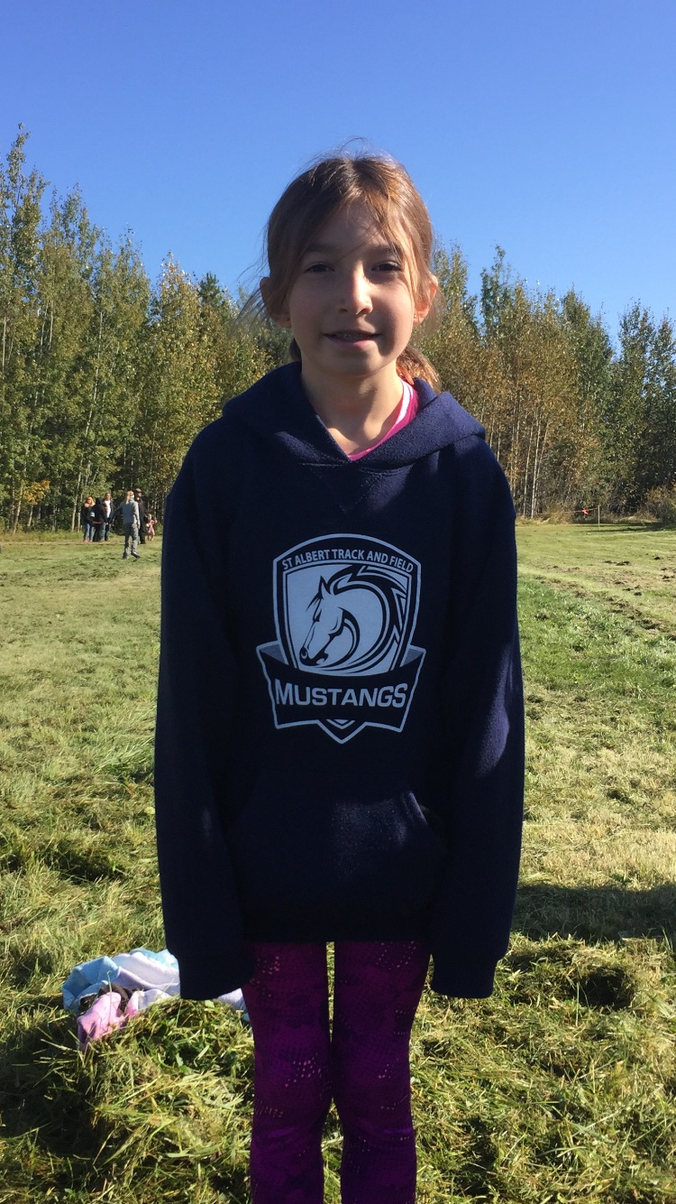
TOP 10 TYKE GIRLS
Melania Jovanovic
Karissa DeSousa
Vivian Wells
Red Deer Titans
Leduc Track and Field Club
Caltaf Athletic Association

Slide 5
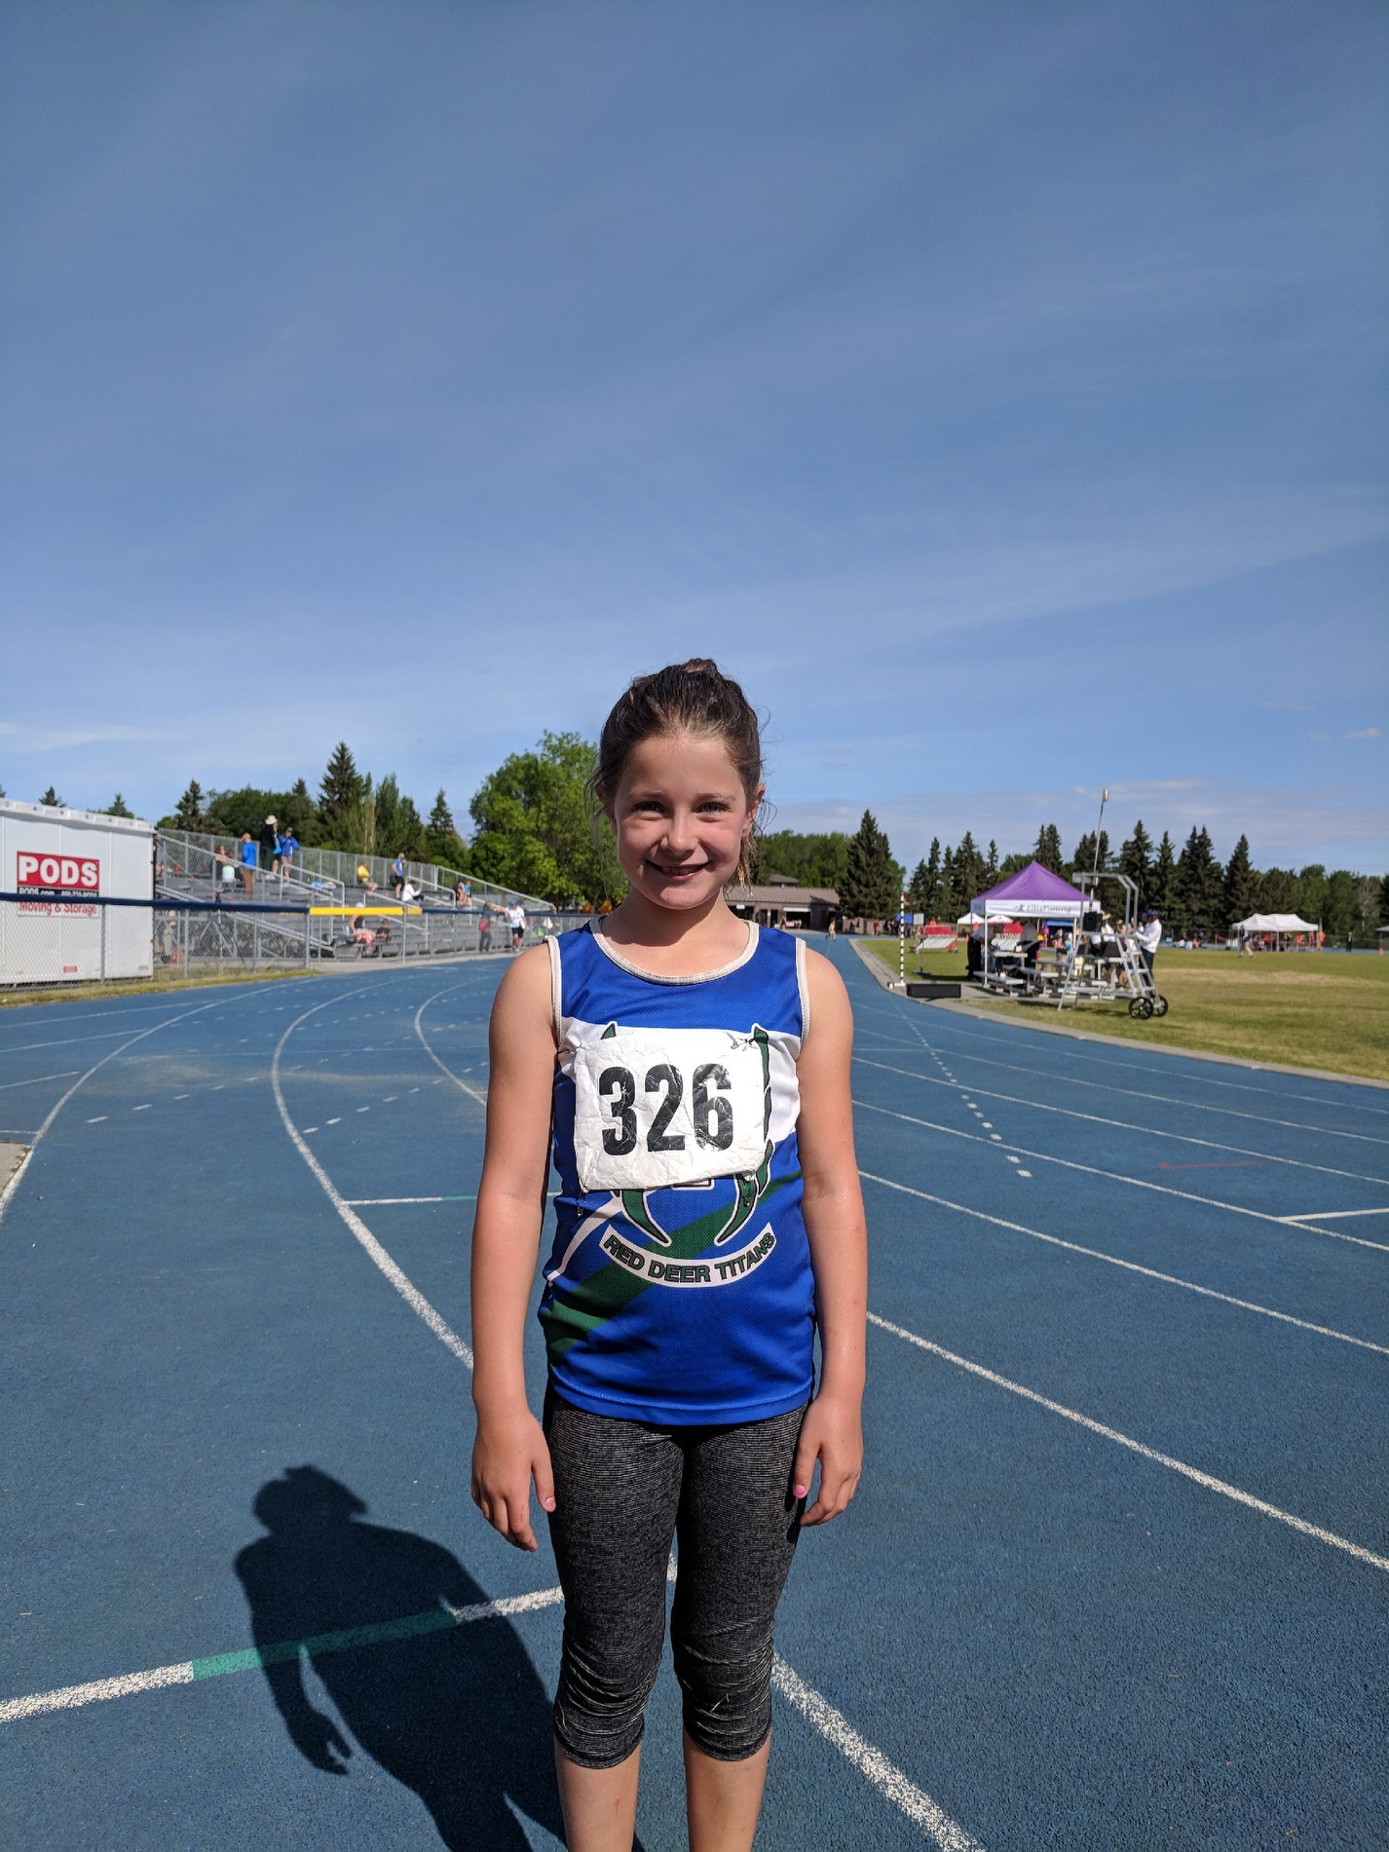
TOP 10 TYKE GIRLS
Dakota Stevenson
Addison Shaw
St. Alberta Mustangs
Red Deer Titans

Slide 6
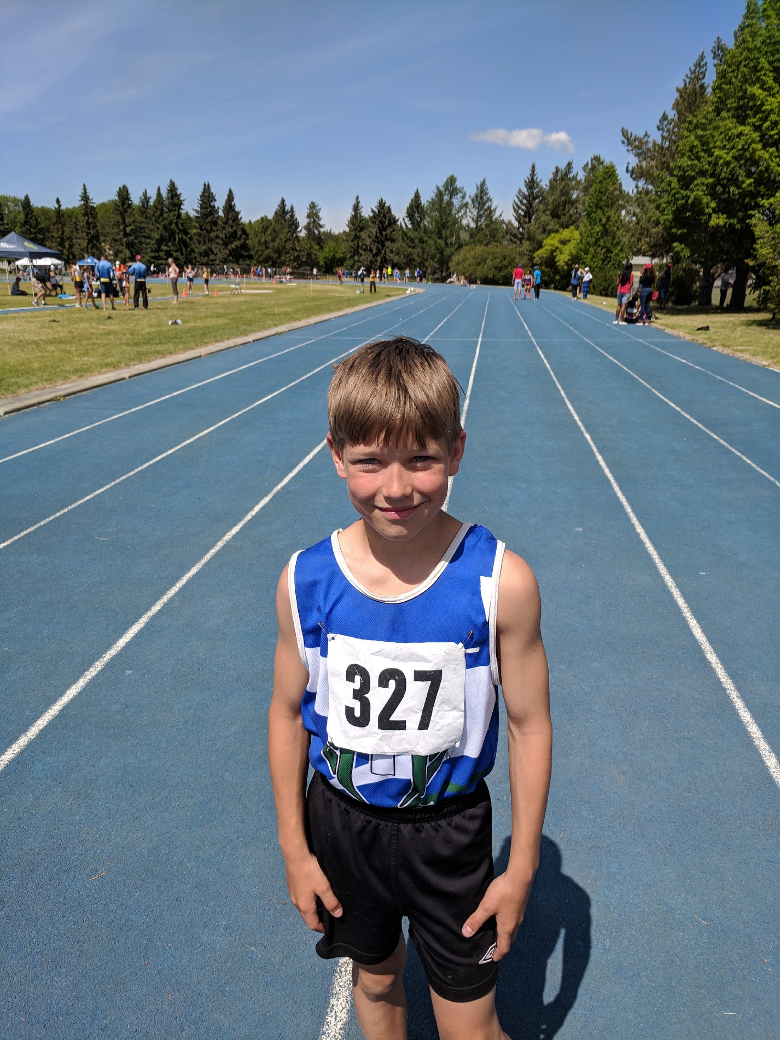
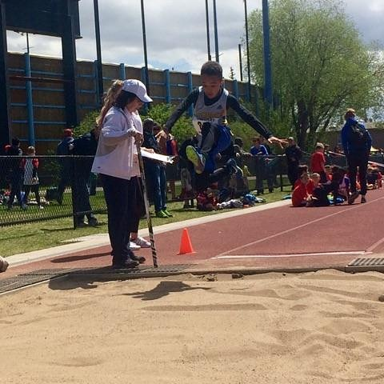
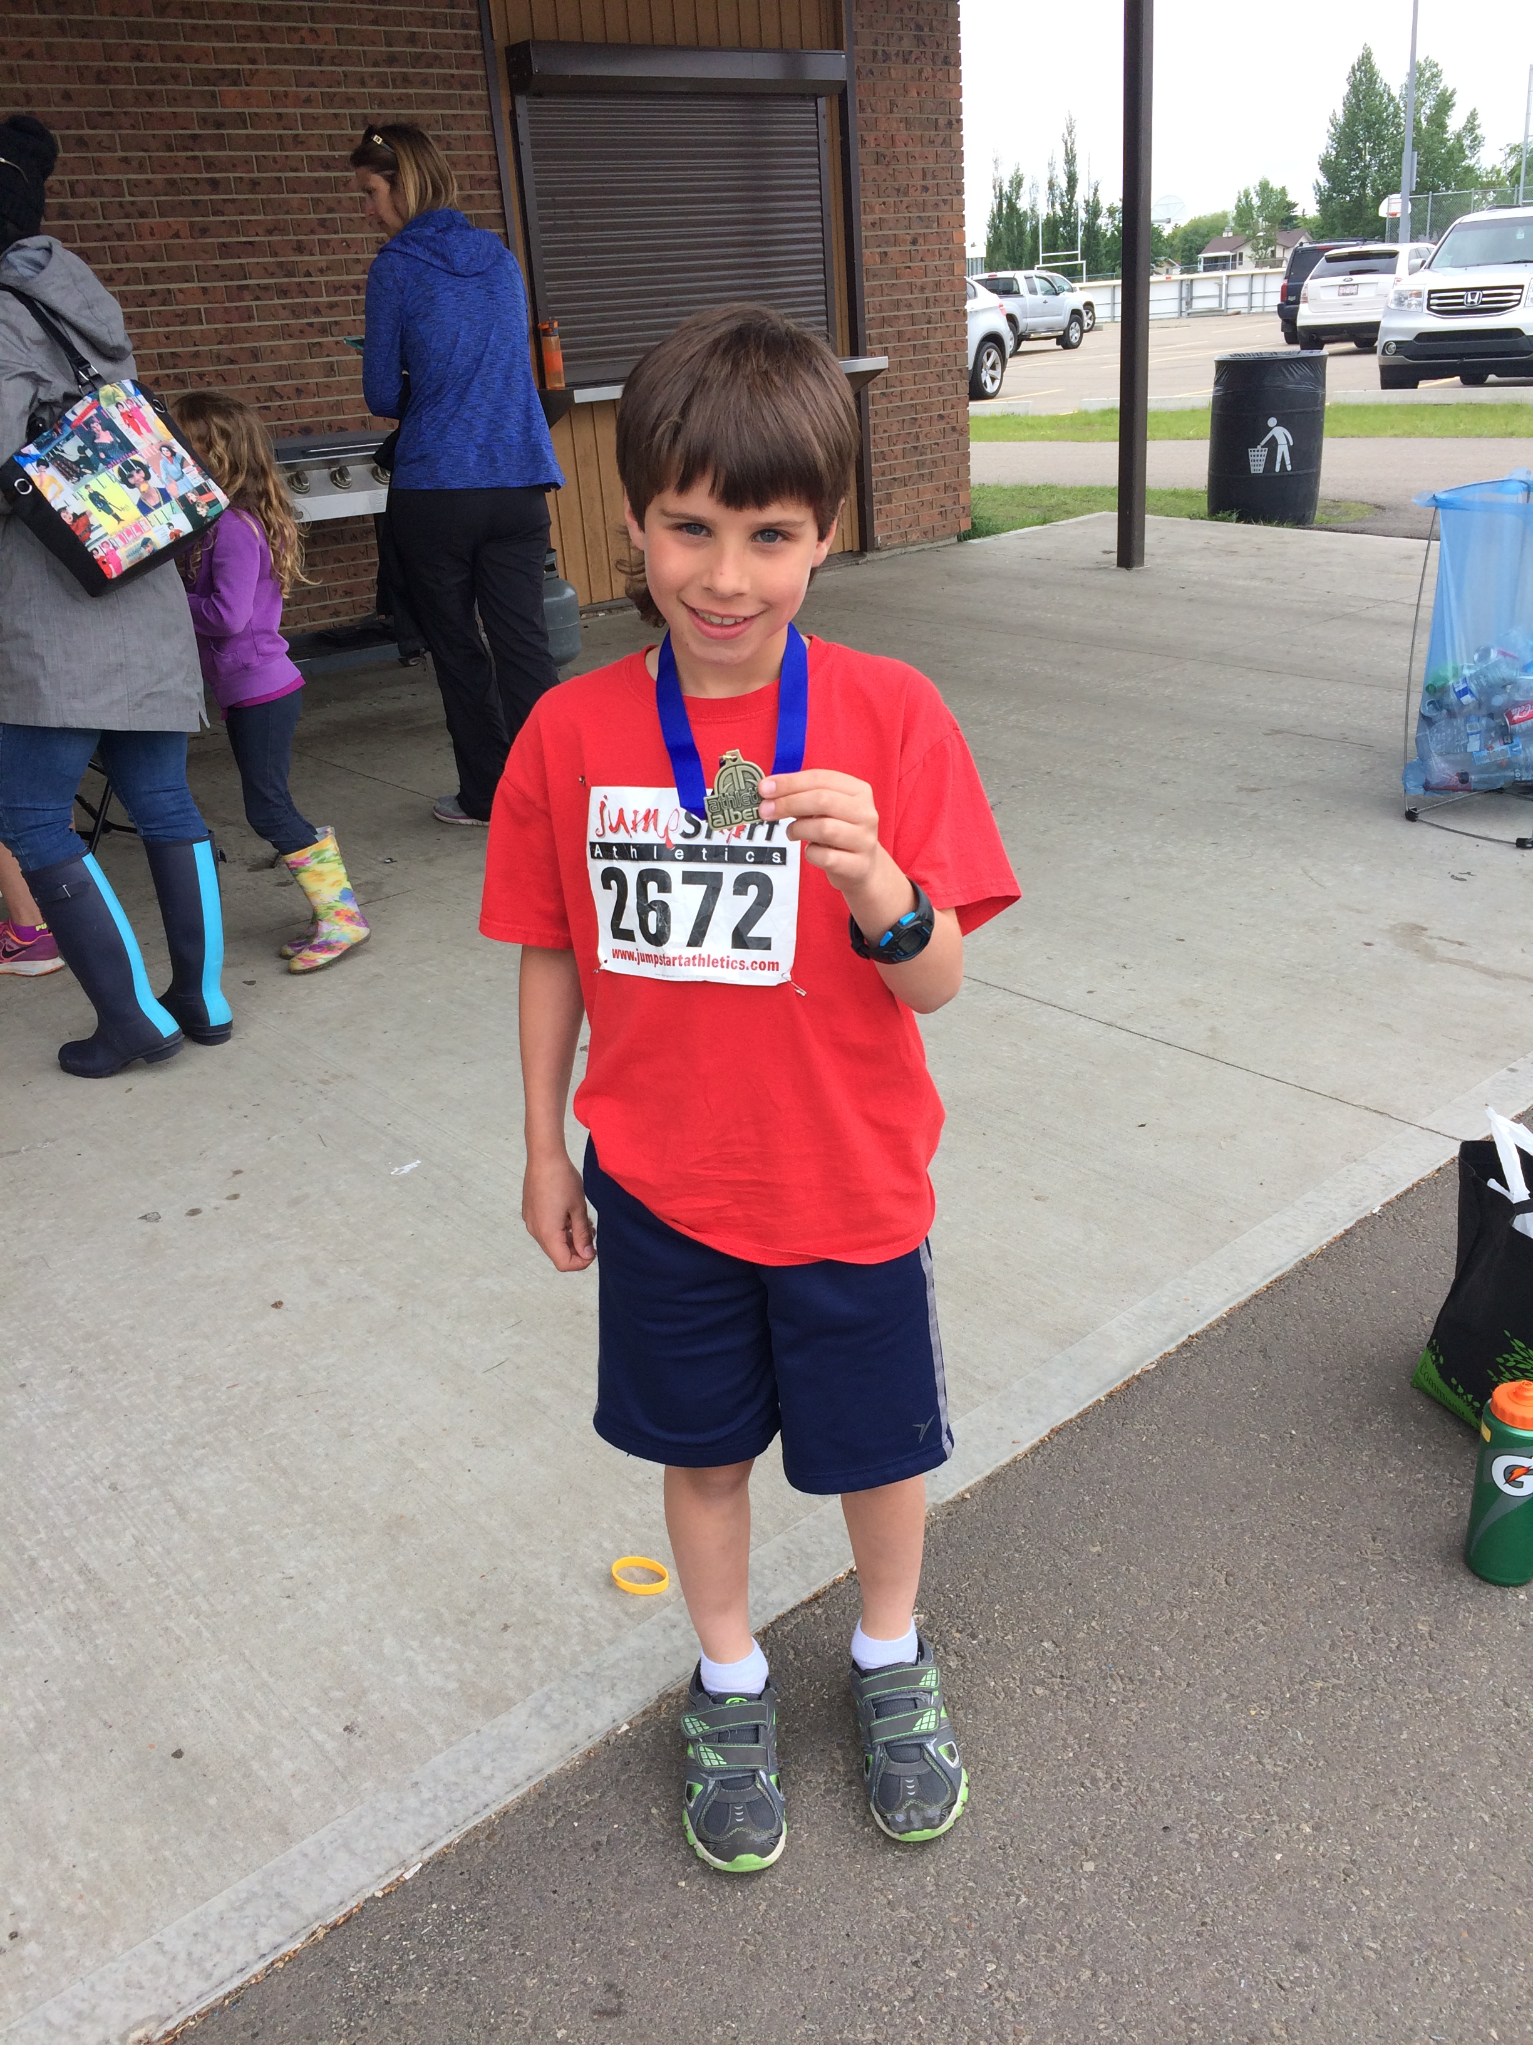
TOP 10 TYKE BOYS
Tayemak Kelsick
Ayden Shaw
Micheal Tzavaras
Airdrie Aces Athletics Club
Caltaf Athletic Association
Red Deer Titans

Slide 7
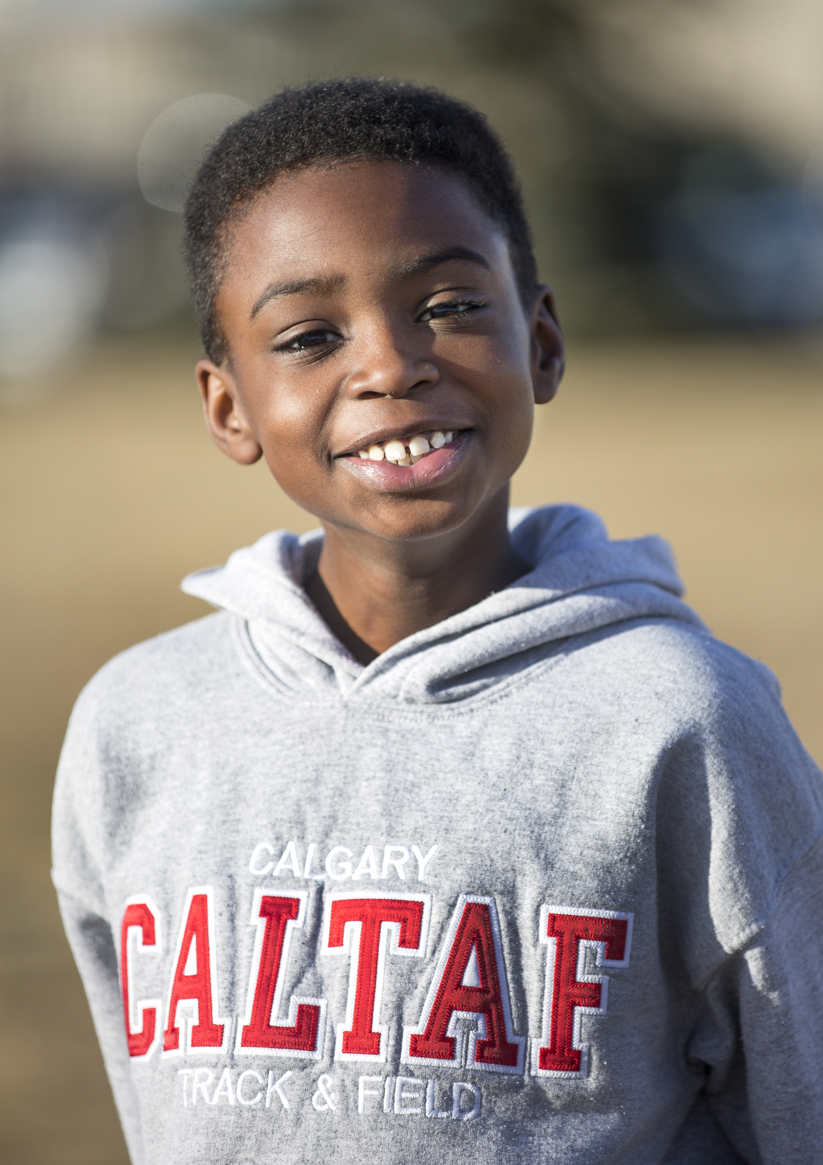
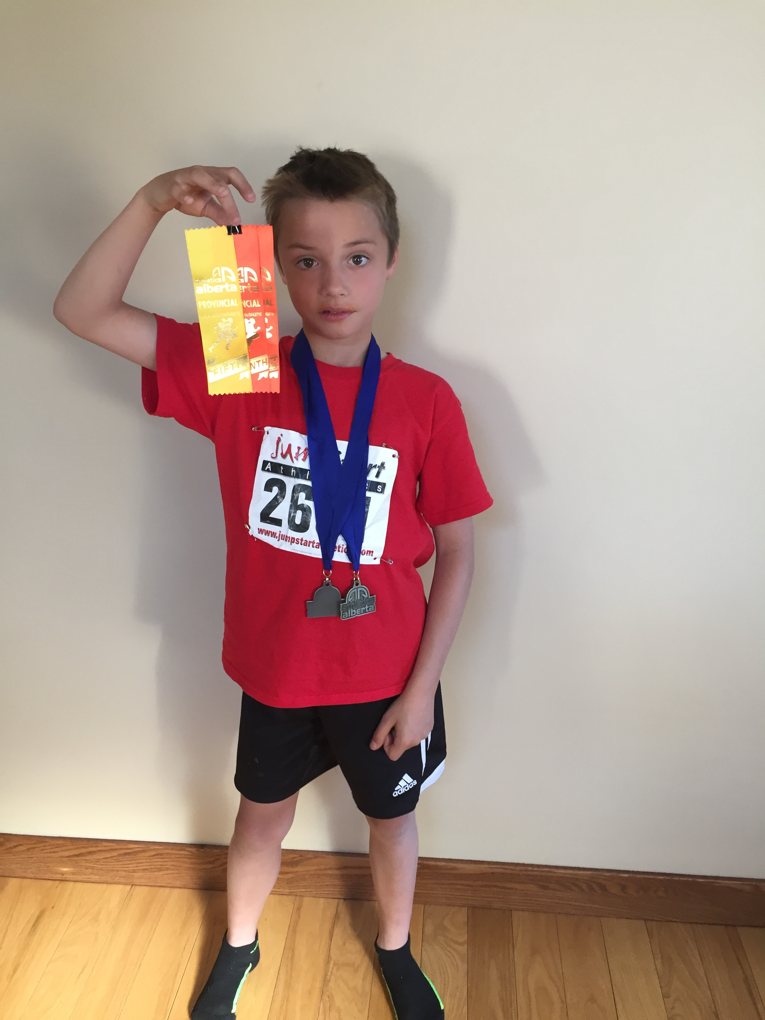
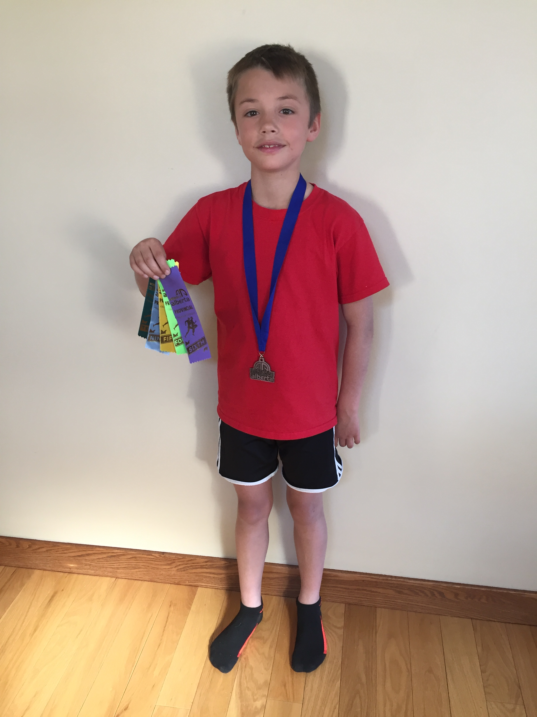
TOP 10 TYKE BOYS
Ephrem Fischer
Thomas Rolston
Jack Rolston
Caltaf Athletic Association
Caltaf Athletic Association
Caltaf Athletic Association

Slide 8
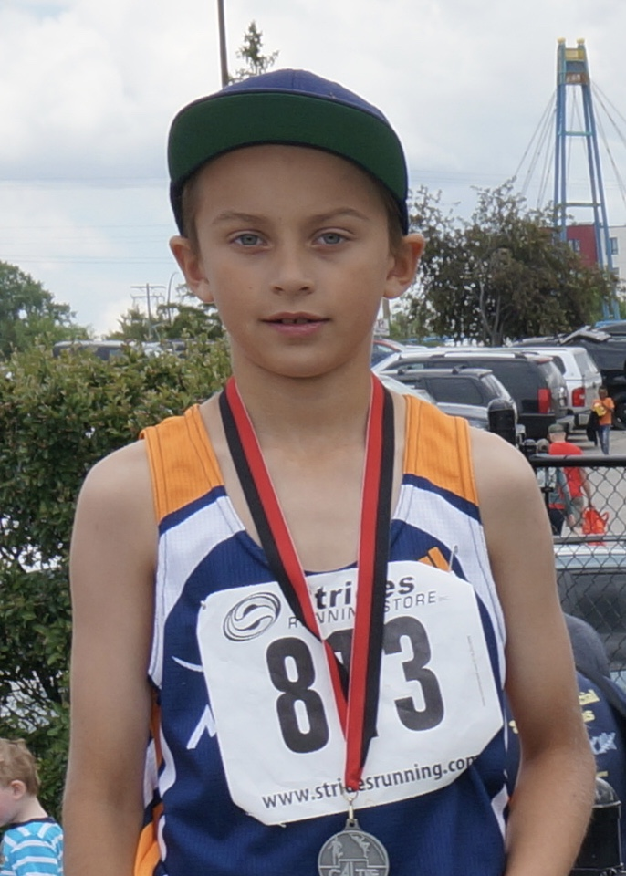
TOP 10 TYKE BOYS
Sehaj Grewal
Silas Kerbes
Easton Herman
Airdrie Aces Athletics Club
St. Alberta Mustangs
St. Alberta Mustangs

Slide 9
TOP 10 TYKE BOYS
Jonathan Urquhart
Kenyen Williams
Asher Singer
Airdrie Aces Athletics Club
St. Alberta Mustangs
Edmonton Olympic Track Club

Slide 10
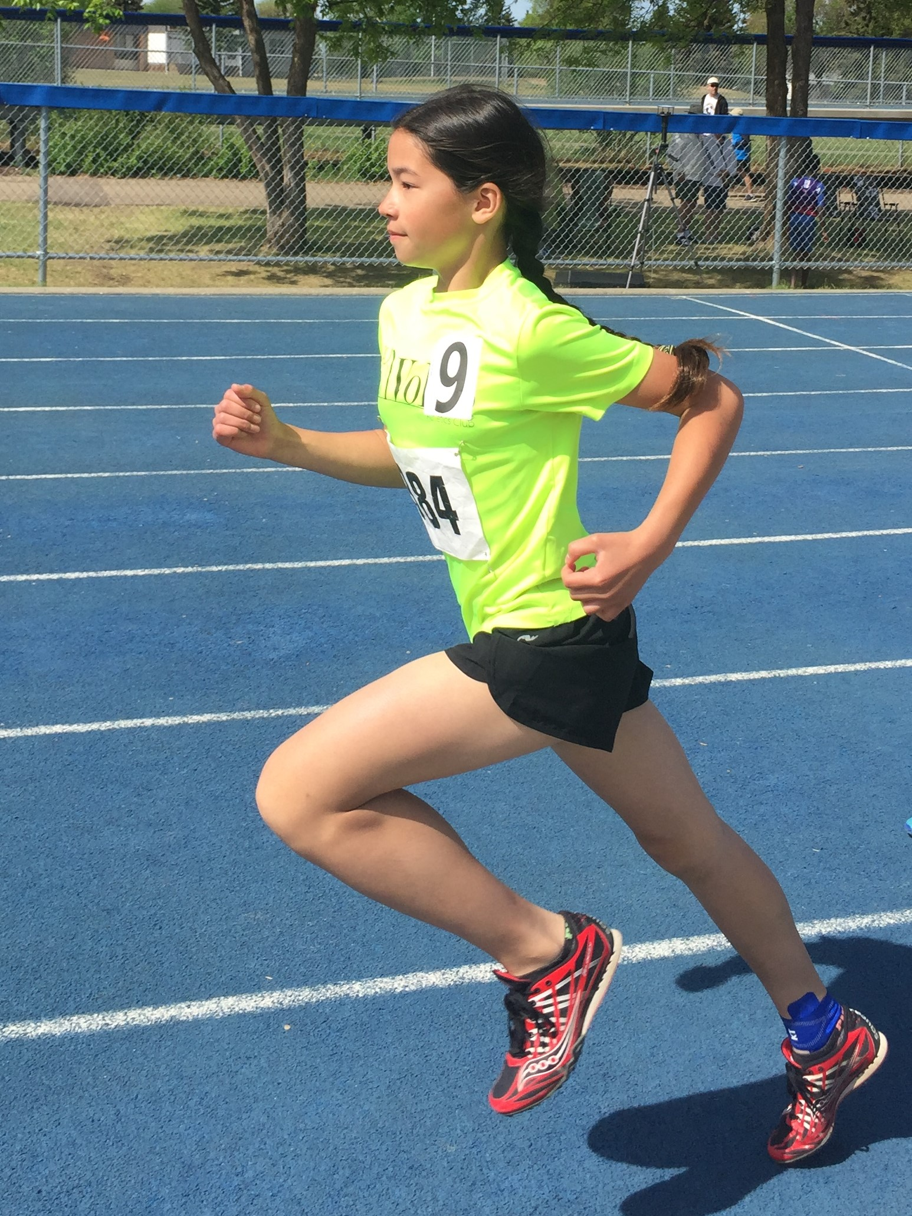
TOP 10 PEE WEE GIRLS
Mya Phippen
Libby Dunn
Carmen Chu
Calgary Spartans
Leduc Track and Field Club
Voleo Athletics

Slide 11
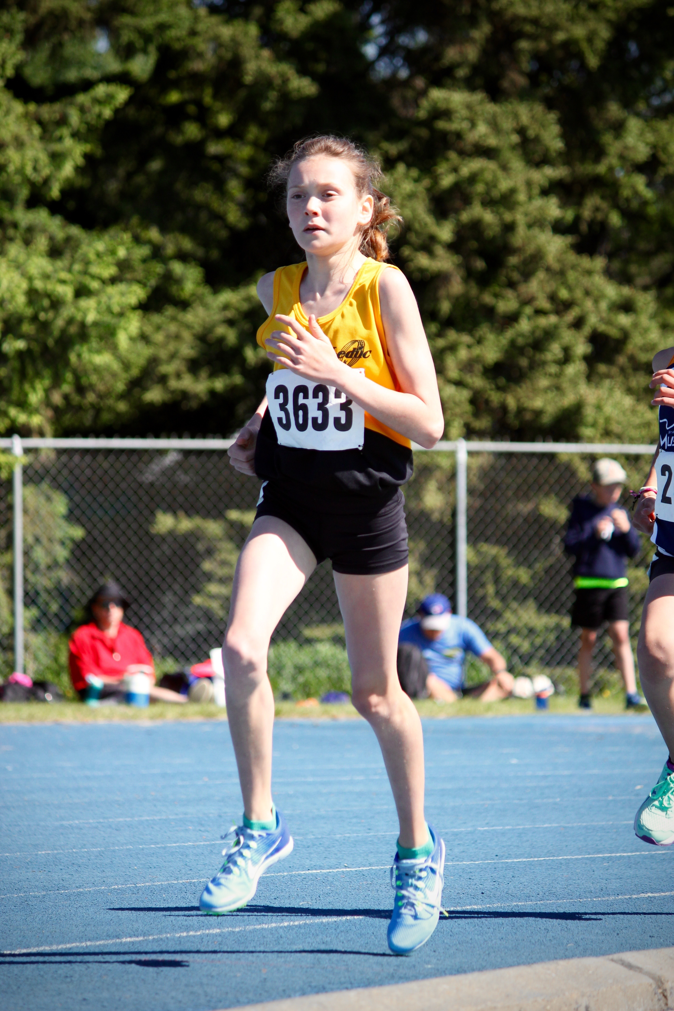
TOP 10 PEE WEE GIRLS
Lucia Baergen
Izabella Seiler
Patrica Draghici
Caltaf Athletic Association
Leduc Track and Field Club
Edmonton Thunder Track Club

Slide 12
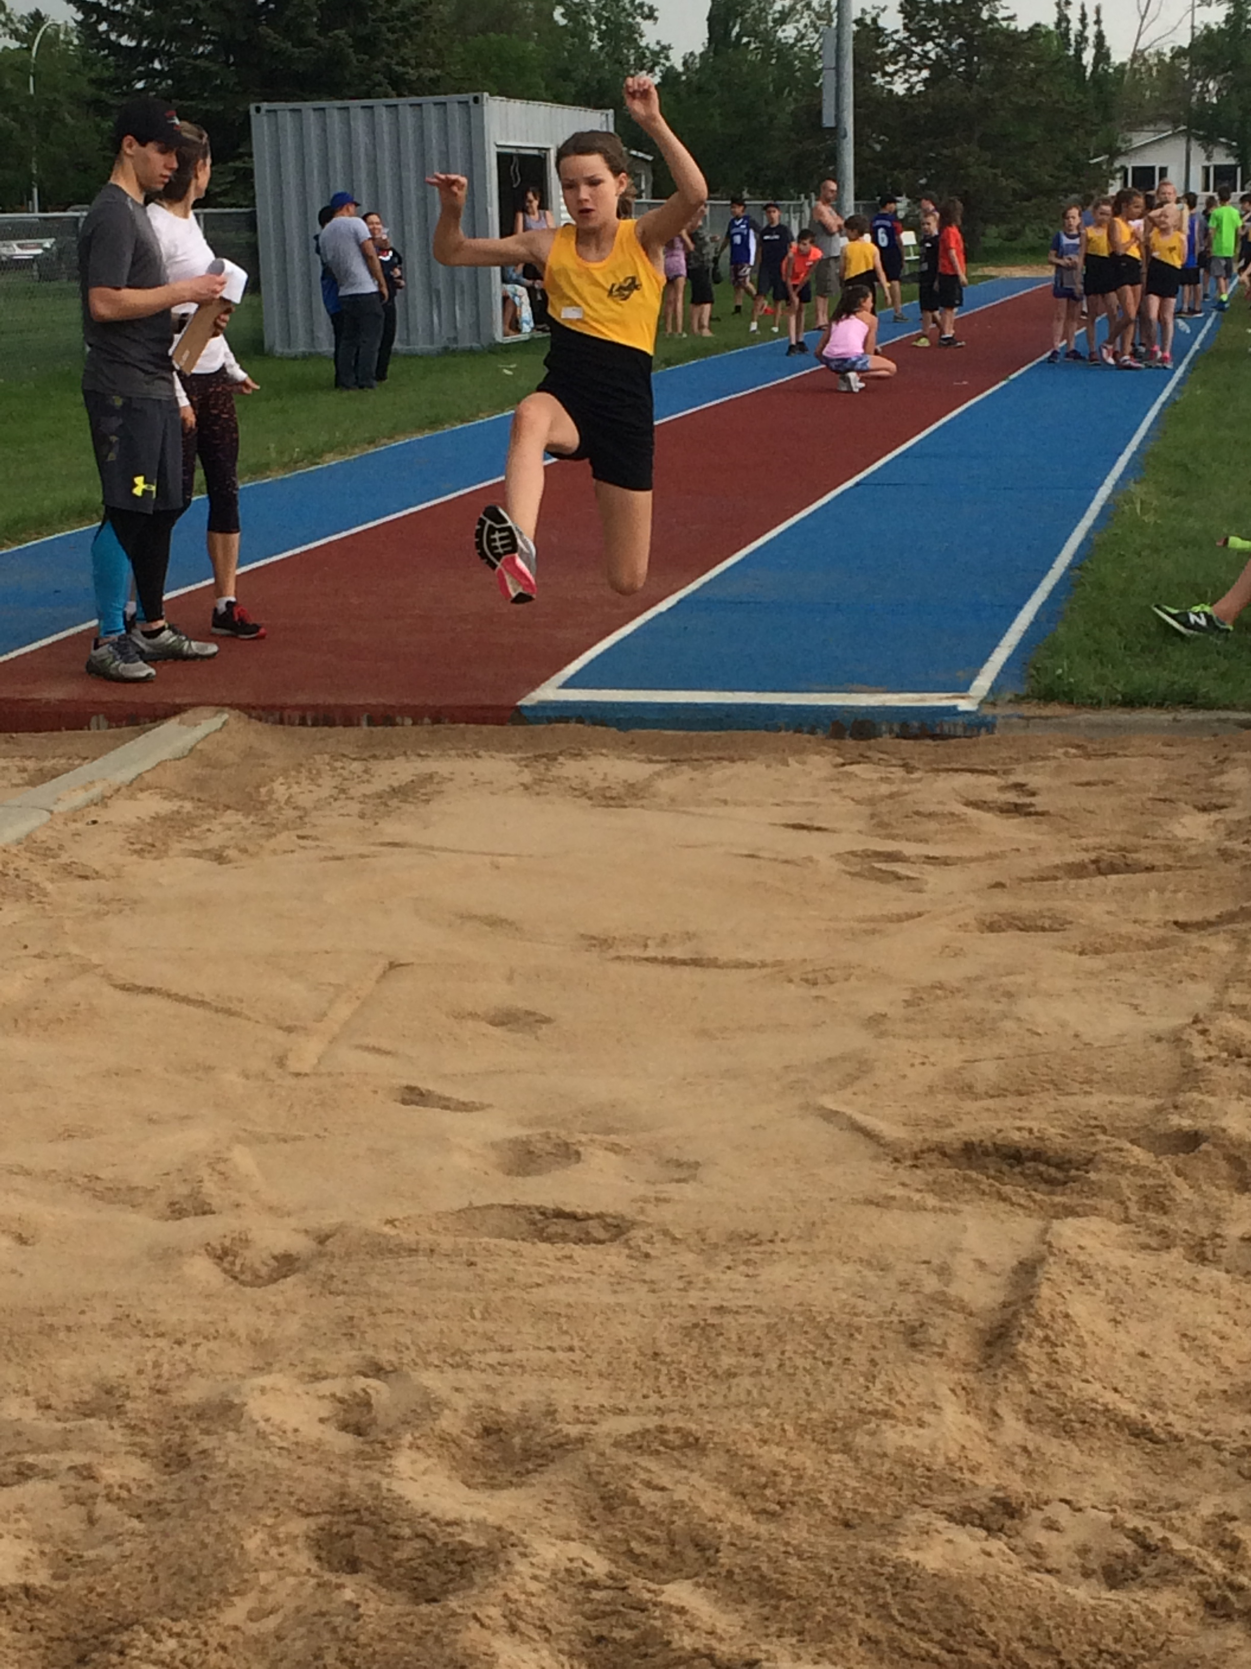
TOP 10 PEE WEE GIRLS
Aylie Dahl
Meadow Drebert
McKenna Fleischhaker
Leduc Track and Field Club
Unattached AB
Leduc Track and Field Club

Slide 13
TOP 10 PEE WEE GIRLS
Sophia Hansen
Christina Hollingworth
Tinsae Stern
Edmonton Columbians
Capital City Track and Field Club
Caltaf Athletic Association

Slide 14
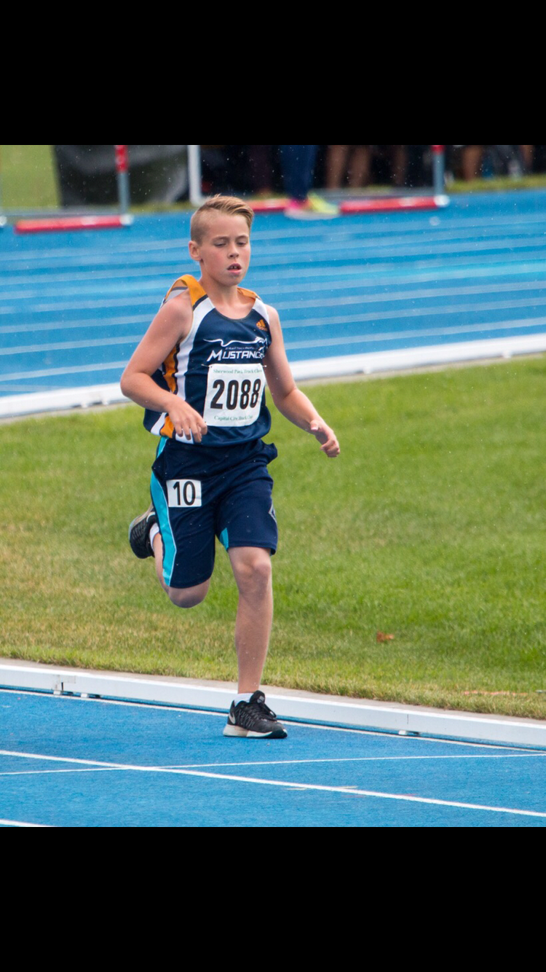
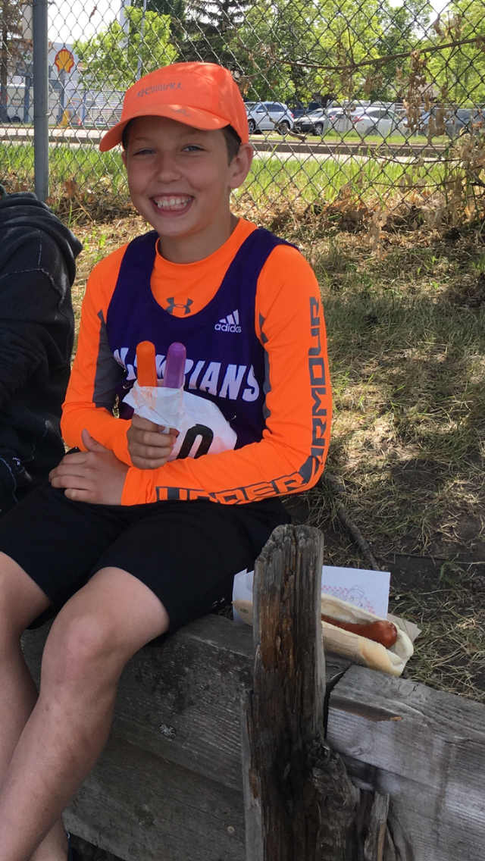
TOP 10 PEE WEE BOYS
Ryan Lofstrom
Luke Christian
St. Albert Mustangs
Jerrett Ross
Edmonton Columbians
Leduc Track and Field Club

Slide 15
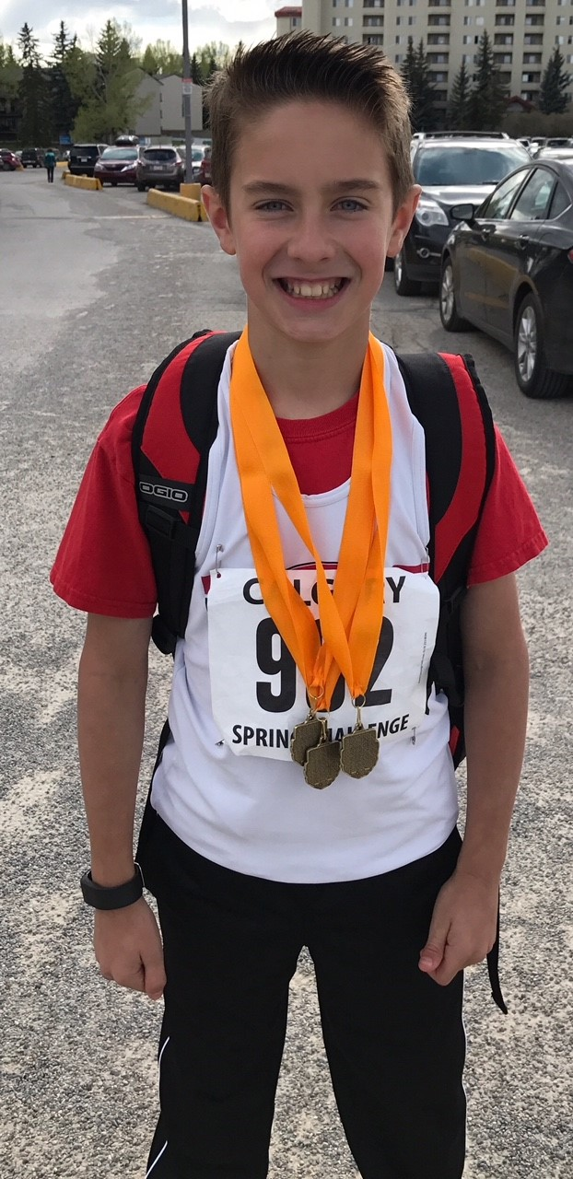
TOP 10 PEE WEE BOYS
Liam Milne
Roenen Chase
Isaiah Baker
Leduc Track and Field Club
Caltaf Athletic Association
Caltaf Athletic Association

Slide 16
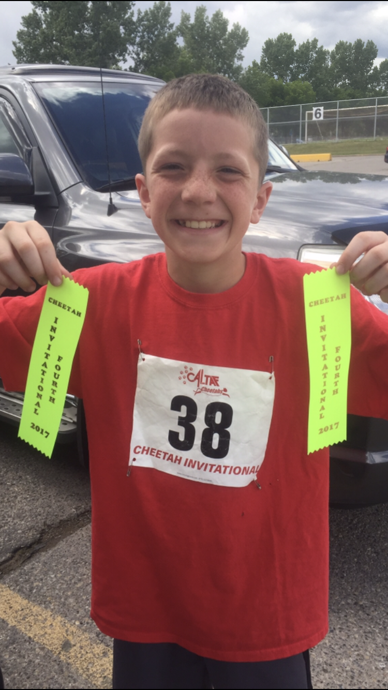
TOP 10 PEE WEE BOYS
Hudson Hallden
Carter Pottruff
Caltaf Athletic Association
Caltaf Athletic Association

Slide 17
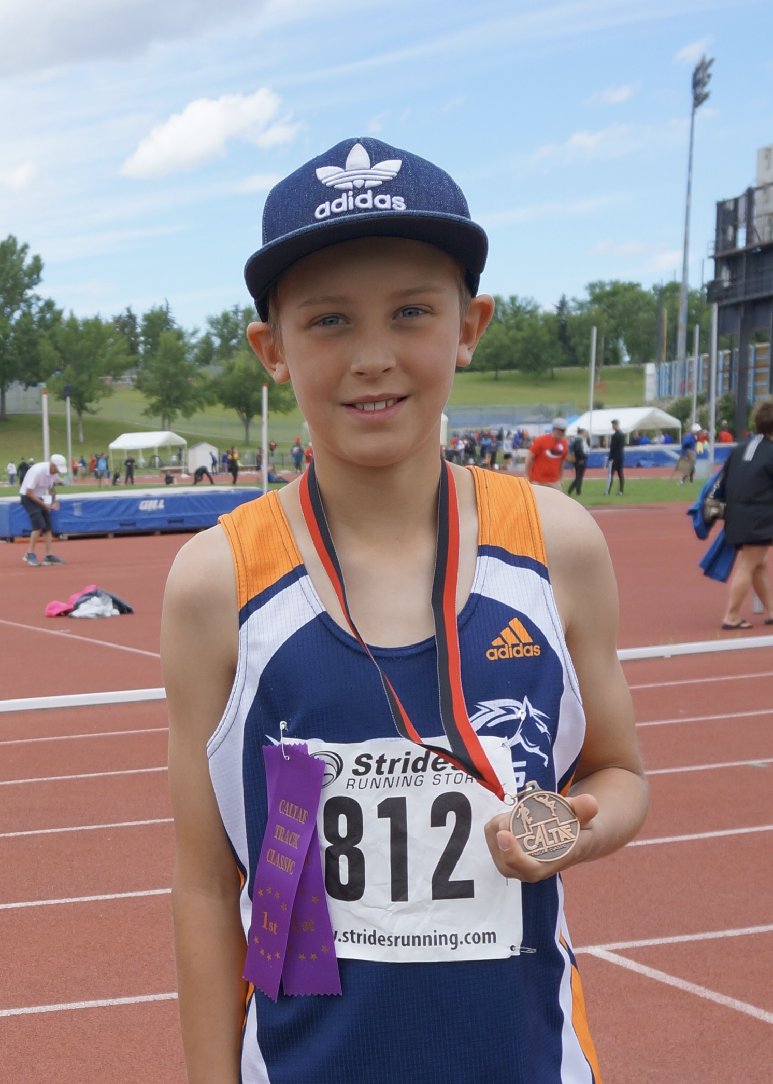
TOP 10 PEE WEE BOYS
Hayes Cooke
Karson Kerbes
Voleo Athletics
St. Albert Mustangs

Slide 18
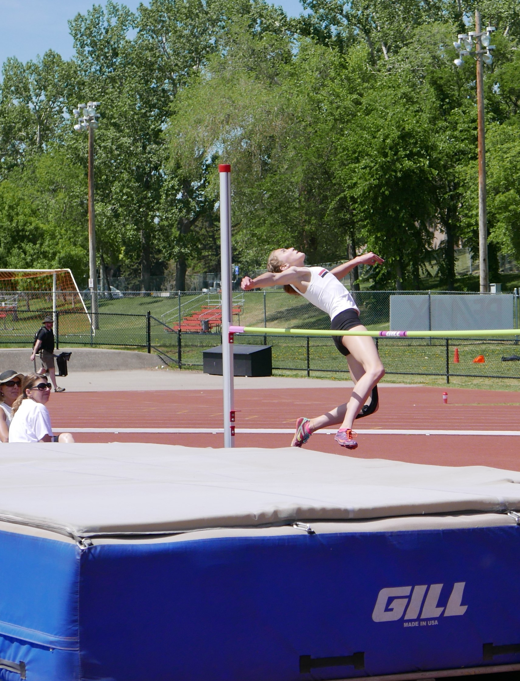
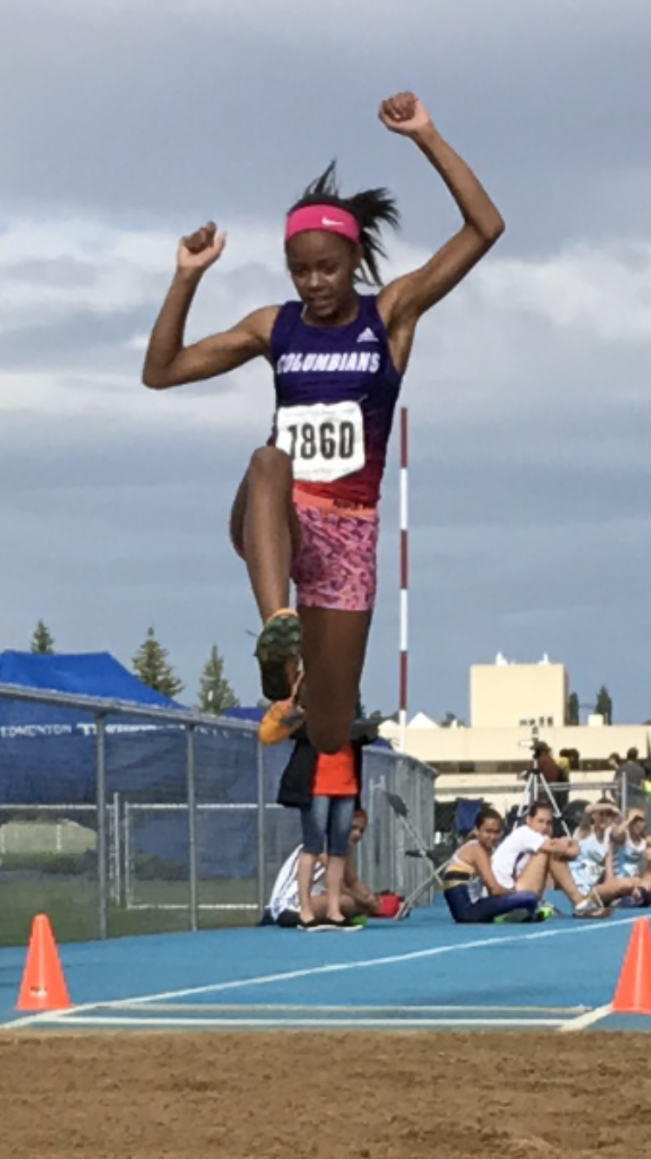
TOP 10 BANTAM GIRLS
Sarah Feschuk
Claire Mackinnon
Whitney LaFayette
Caltaf Athletic Association
Caltaf Athletic Association
Edmonton Columbians

Slide 19
TOP 10 BANTAM GIRLS
Karen Mah
Journi Thompson
Brynn Hobal
Edmonton Harriers Track Club
Edmonton Olympic Track Club
Edmonton Harriers Track Club

Slide 20
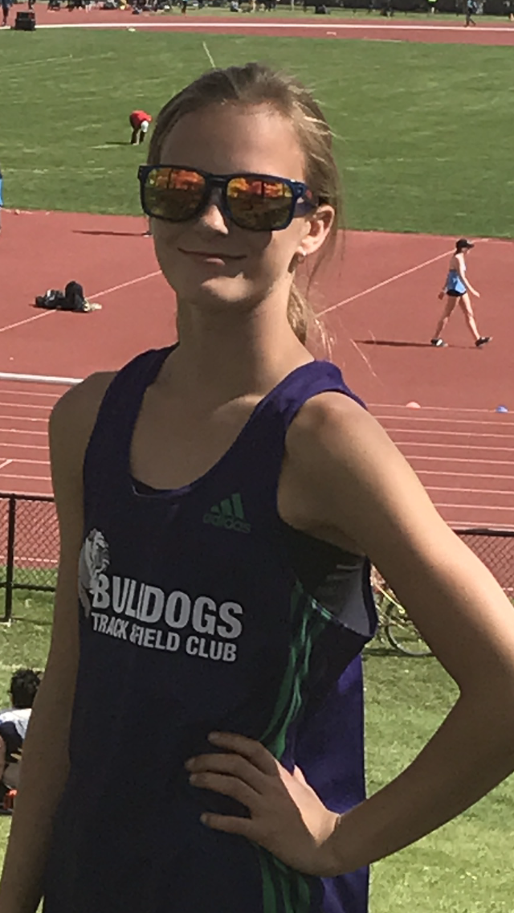
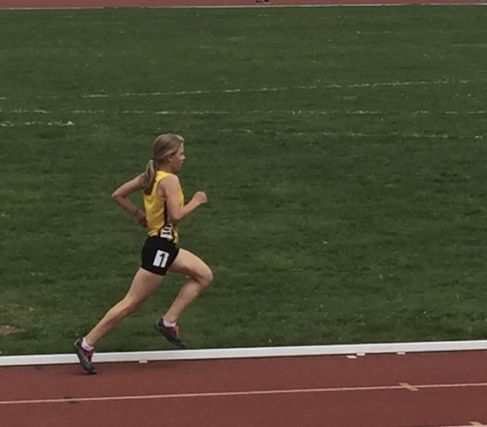
TOP 10 BANTAM GIRLS
Evonne Henning
Jayel Dovichak
Calgary Warriors
Bulldogs Track and Field Club

Slide 21
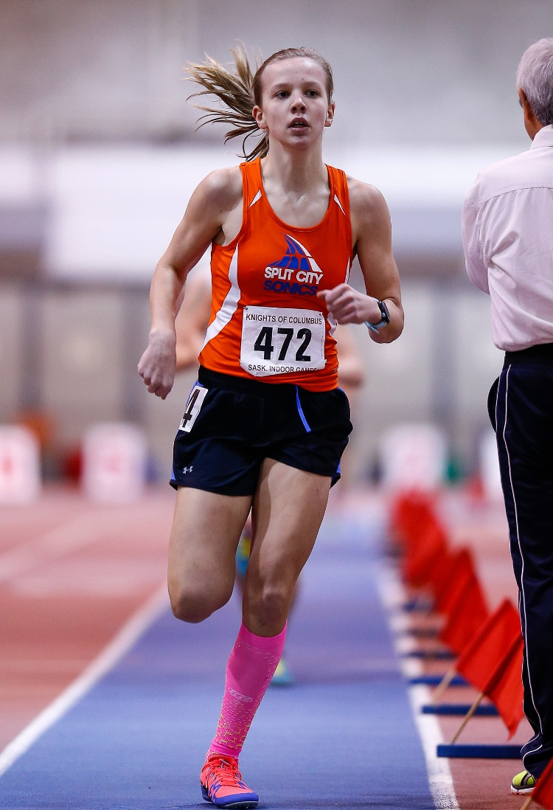
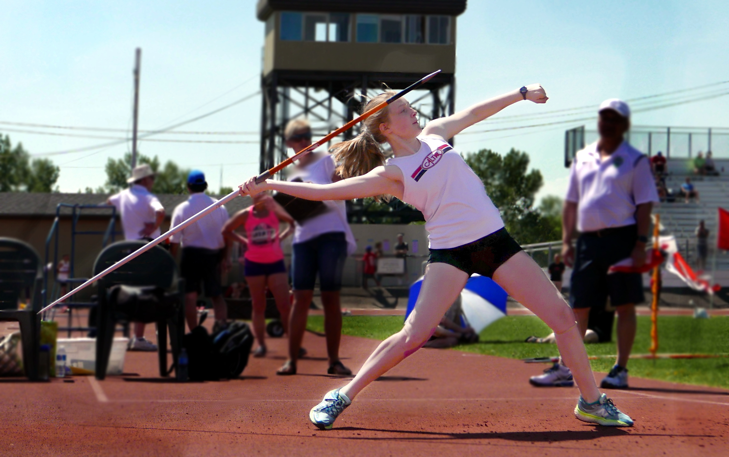
TOP 10 BANTAM GIRLS
Meghan Perri
Abbigale Kirsch
Caltaf Athletic Association
Split City Sonics

Slide 22
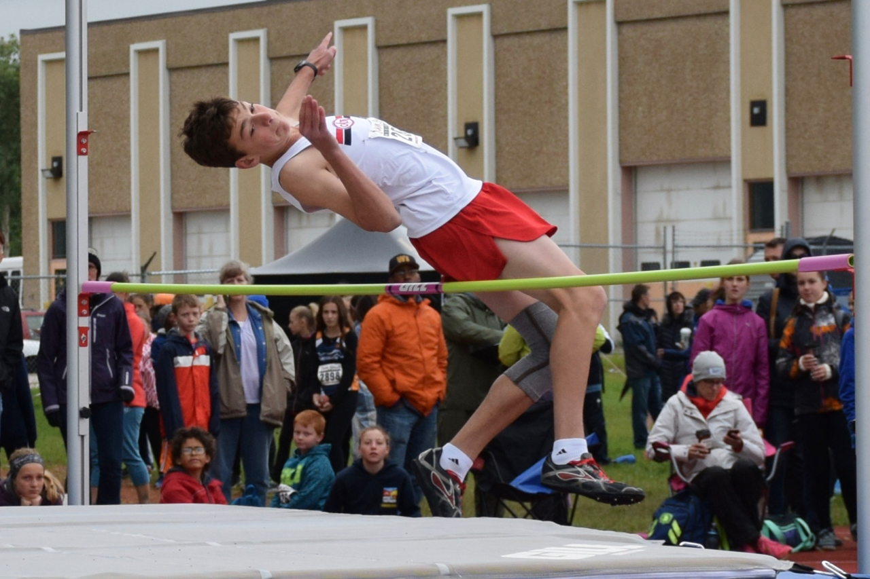
TOP 10 BANTAM BOYS
Tyler Sharpe
Mats Swanson
Caltaf Athletic Association
Duncan Critch
Leduc Track and Field Club
Lakeland Yellow Jackets

Slide 23
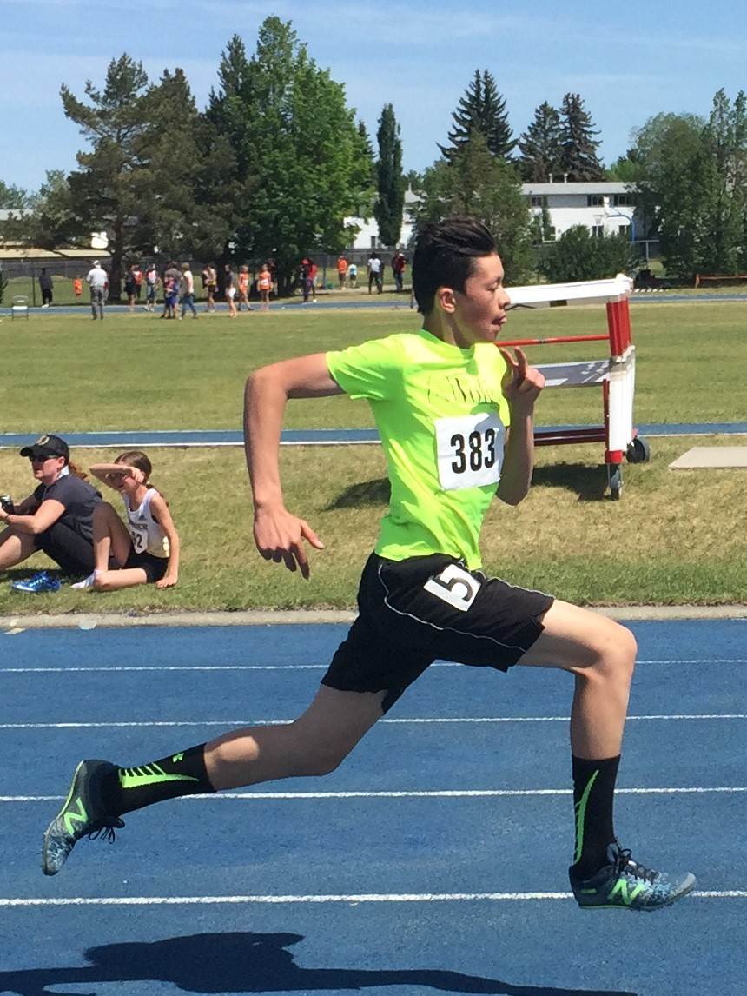
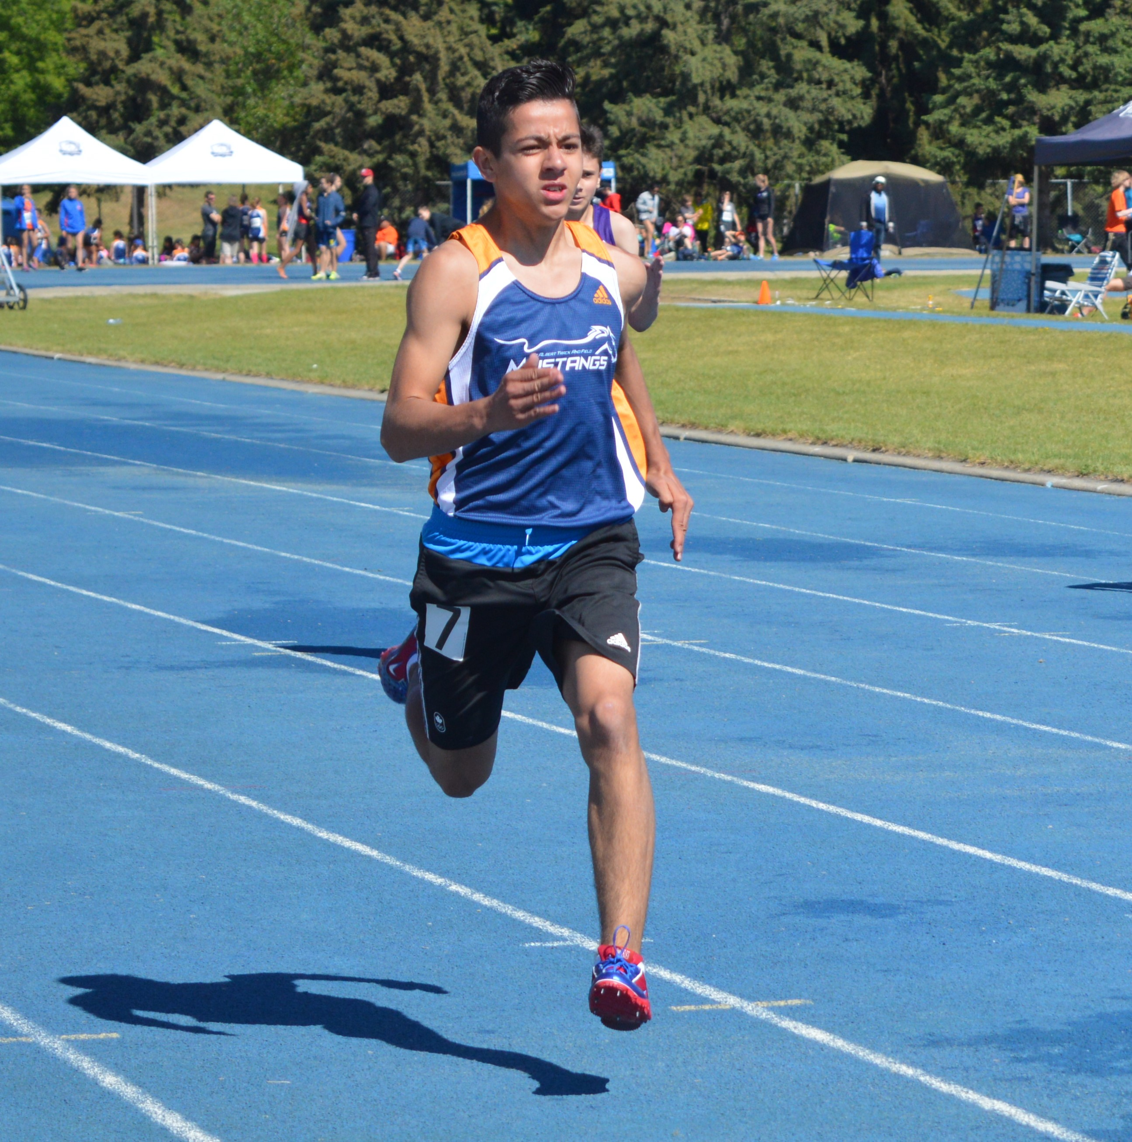
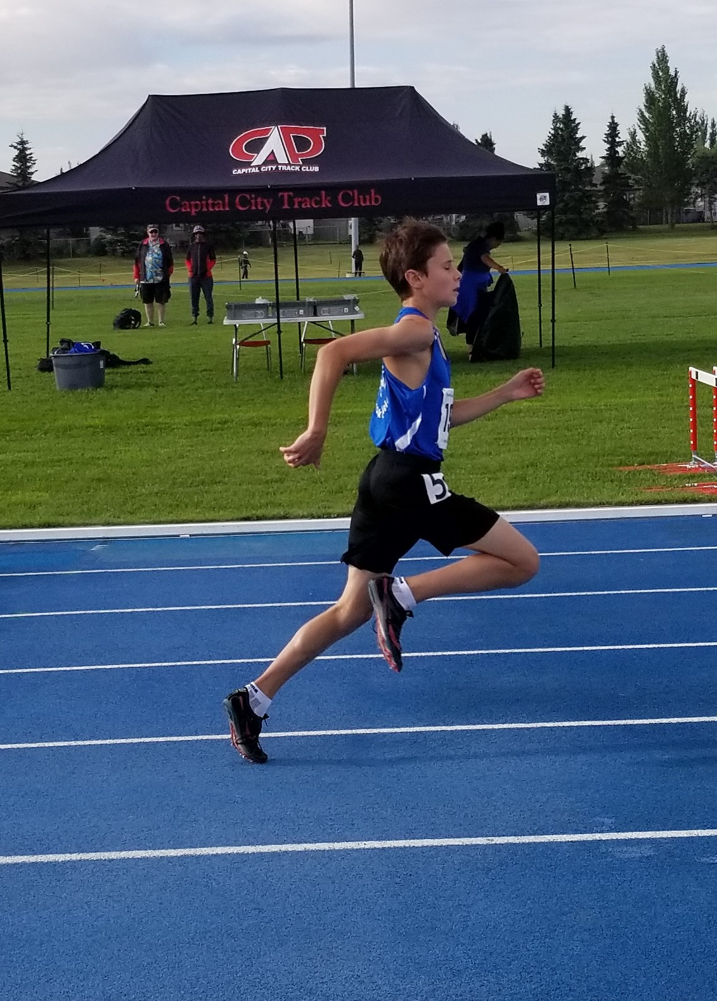
TOP 10 BANTAM BOYS
Ethan Tweten
Carl Chu
Logan Shaver
St. Albert Mustangs
Voleo Athletics
Edmonton Olympic Track Club

Slide 24
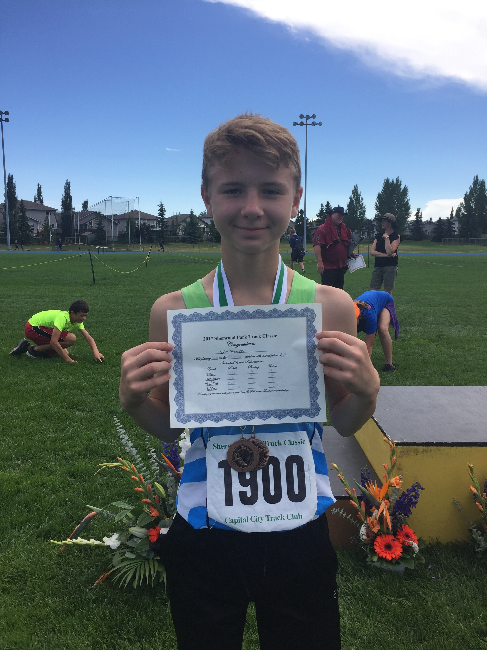
TOP 10 BANTAM BOYS
Brycen Lowes
Luke Dawson
Eric Boyko
Airdrie Aces Athletics Club
Edmonton Columbians
Edmonton Harriers Track Club

Slide 25
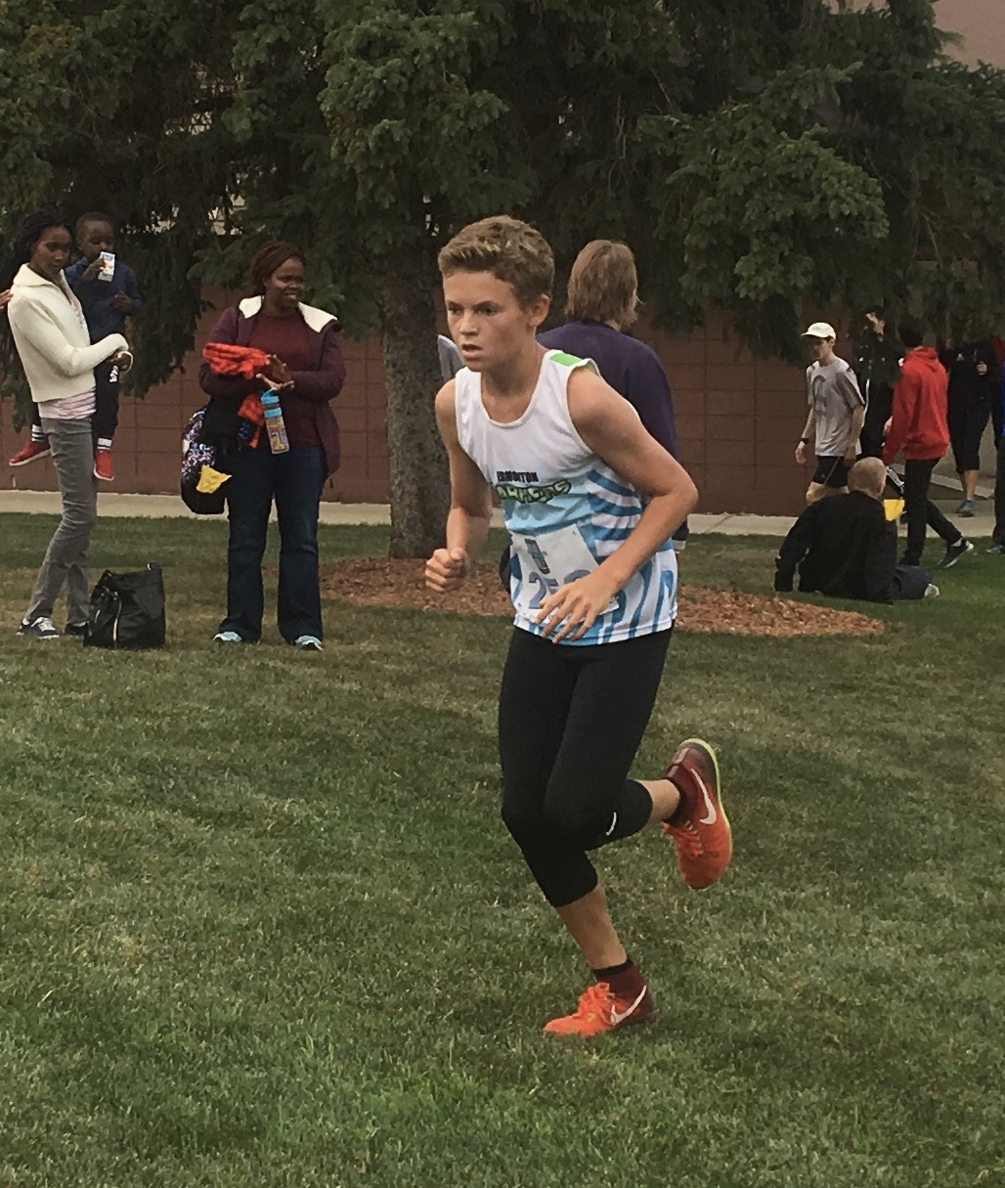
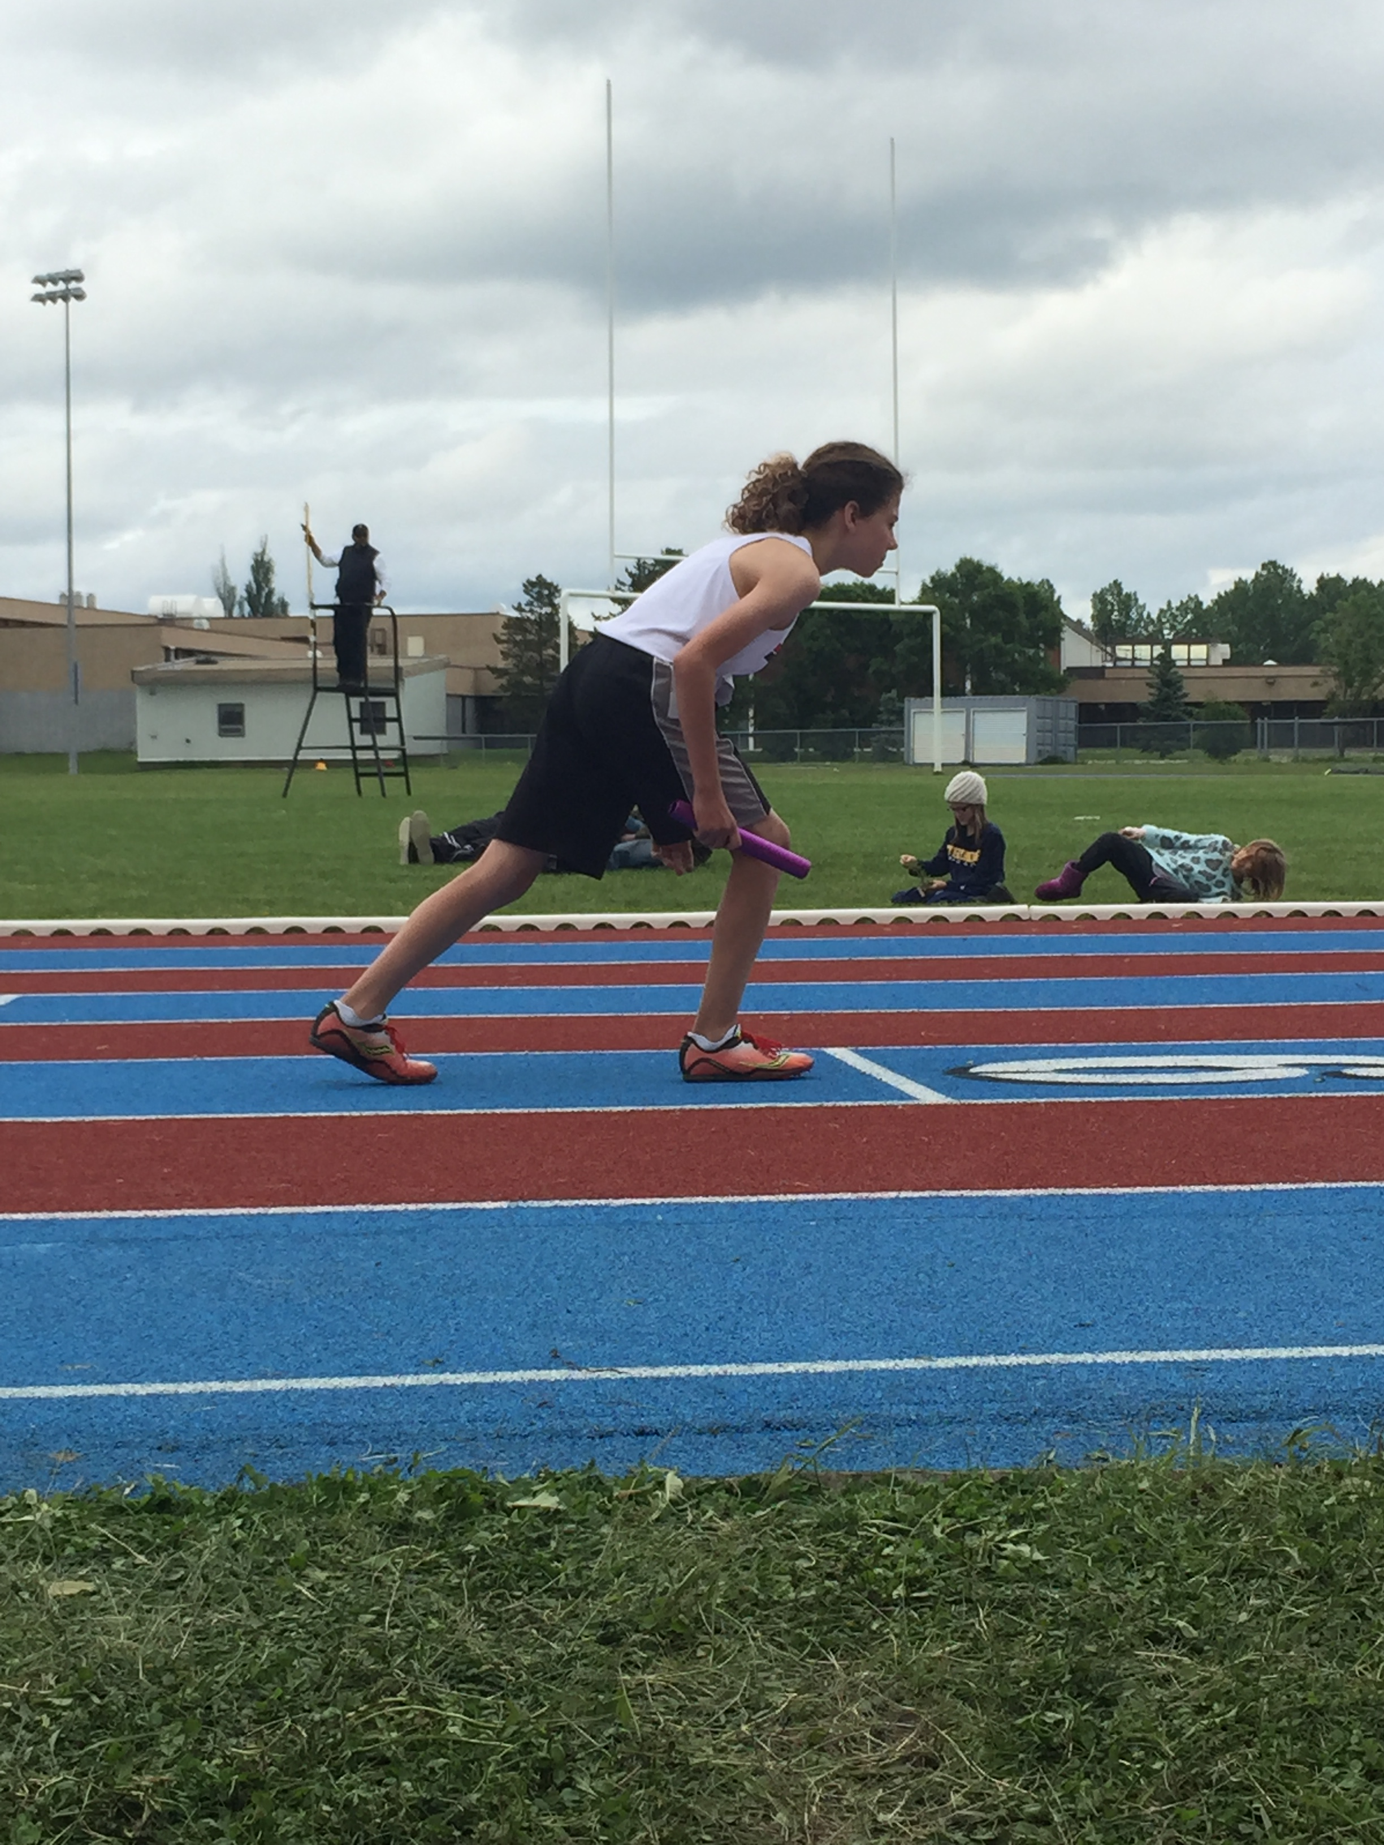
TOP 10 BANTAM BOYS
Keenan Desmarais
Benjamin Jansen
Caltaf Athletic Association
Edmonton Harriers Track Club

Slide 26
The Alberta NWT Command of the Royal Canadian Legion is proud to present the 2017 Ron Rivard Memorial Trophy to the athlete that shows outstanding character and commitment to the Provincial Legion program This years recipients are Ryder Horton Voleo Athletic Club

Slide 27
Chloe Palmer Edmonton Harriers
2017 Midget Female Track & Field
Award Nominee
Supported by

Slide 28
Sadie Sigfstead
Edmonton Harriers
2017 Midget Female Track & Field
Award Nominee
Supported by

Slide 29
Ella Clayton
Caltaf Athletic Association
2017 Midget Female Track & Field
Award Nominee
Supported by

Slide 30
Natasha Gatzke
Calgary Warriors
2017 Midget Female Track & Field
Award Nominee
Supported by

Slide 31
Hannah Heise
Edmonton Olympic Track Club
2017 Midget Female Track & Field
Award Nominee
Supported by

Slide 32
Skylar Sieben
Caltaf Athletic Association
2017 Youth Female Track & Field
Award Nominee
Supported by

Slide 33
Erika Binder
Caltaf Athletic Association
2017 Youth Female Track & Field
Award Nominee
Supported by

Slide 34
Julia Lovsin
Edmonton Harriers
2017 Youth Female Track & Field
Award Nominee
Supported by

Slide 35
Emma Bauer
Chinook Track and Field Club
2017 Youth Female Track & Field
Award Nominee
Supported by

Slide 36
Kiara Tan
YEG Lightning
2017 Youth Female Track & Field
Award Nominee
Supported by

Slide 37
Savanna Jordan
Caltaf Athletic Association
2017 Junior Female Track & Field
Award Nominee
Supported by

Slide 38
Emma Hubbard
Caltaf Athletic Association
2017 Junior Female Track & Field
Award Nominee
Supported by

Slide 39
Janae Watts
Caltaf Athletic Association
2017 Junior Female Track & Field
Award Nominee
Supported by

Slide 40
Gabrielle Rains
Apex Athletics Club
2017 Junior Female Track & Field
Award Nominee
Supported by

Slide 41
Jessica O’Connell
U of C Athletics Club
2017 Senior Female Track & Field
Award Nominee
Supported by

Slide 42
Sage Watson
Calgary International Track Club
2017 Senior Female Track & Field
Award Nominee
Supported by

Slide 43
Liz Gleadle
Chinook Track and Field Club
2017 Senior Female Track & Field
Award Nominee
Supported by

Slide 44
Angela Whyte
Apex Athletics Club
2017 Senior Female Track & Field
Award Nominee
Supported by

Slide 45
Mathias Gelber
Pass Trak
2017 Midget Male Track & Field
Award Nominee
Supported by

Slide 46
Zachary Poirier
Calgary Warriors
2017 Midget Male Track & Field
Award Nominee
Supported by

Slide 47
Jared Howse
Red Deer Titans
2017 Midget Male Track & Field
Award Nominee
Supported by

Slide 48
Kobe Grocholski
Wolves Athletic Club
2017 Midget Male Track & Field
Award Nominee
Supported by

Slide 49
Maximus Thiessen
U of C Athletics Club
2017 Youth Male Track & Field
Award Nominee
Supported by

Slide 50
Scott Dixon
Capital City Track and Field Club
2017 Youth Male Track & Field
Award Nominee
Supported by

Slide 51
Sheldon Louza
Calgary International Track Club
2017 Youth Male Track & Field
Award Nominee
Supported by

Slide 52
Ryder Horton
Voleo Athletics
2017 Youth Male Track & Field
Award Nominee
Supported by

Slide 53
Austin Cole
Capital City Track and Field Club
2017 Junior Male Track & Field
Award Nominee
Supported by

Slide 54
Marco Arop
Voleo Athletics
2017 Junior Male Track & Field
Award Nominee
Supported by

Slide 55
Wesley Calef
Green and Gold Track and Field Club
2017 Junior Male Track & Field
Award Nominee
Supported by

Slide 56
Andreas Troschke
Chinook Track and Field Club
2017 Junior Male Track & Field
Award Nominee
Supported by

Slide 57
Rhys Kramer
Caltaf Athletic Association
2017 Junior Male Track & Field
Award Nominee
Supported by

Slide 58
Aaron Hernandez
Chinook Track and Field Club
2017 Senior Male Track & Field
Award Nominee
Supported by

Slide 59
Deryk Theodore
Edmonton International Track and Field Club
2017 Senior Male Track & Field
Award Nominee
Supported by

Slide 60
Gareth Hadfield
Caltaf Athletic Association
2017 Senior Male Track & Field
Award Nominee
Supported by

Slide 61
Cole Peterson
Edmonton Harriers
2017 Senior Male Track & Field
Award Nominee
Supported by

Slide 62
Karissa De Sousa
St. Albert Mustangs
2017 Tyke Female Cross County
Award Winner
Supported by

Slide 63
Libby Dunn
Leduc Track and Field Club
2017 PeeWee Female Cross County
Award Winner
Supported by

Slide 64
Holly Pougnet
Edmonton Harriers
2017 Bantam Female Cross County
Award Winner
Supported by

Slide 65
Sadie Sigfstead
Edmonton Harriers
2017 Midget Female Cross County
Award Winner
Supported by

Slide 66
Olivia Cooper
Edmonton Harriers
2017 Youth Female Cross County
Award Winner
Supported by

Slide 67
Savanna Jordon
Caltaf Athletic Association
2017 Junior Female Cross County
Award Winner
Supported by

Slide 68
Emma Cook-Clarke
U of C Athletics Club
2017 Senior Female Cross County
Award Winner
Supported by

Slide 69
Ephrem Fischer
Caltaf Athletic Association
2017 Tyke Male Cross County
Award Winner
Supported by

Slide 70
Max Bailey
Caltaf Athletic Association
2017 PeeWee Male Cross County
Award Winner
Supported by

Slide 71
Keenan Desmarais
Edmonton Harriers
2017 Bantam Male Cross County
Award Winner
Supported by

Slide 72
Jared Howe
Red Deer Titans
2017 Midget Male Cross County
Award Winner
Supported by

Slide 73
Maximus Thiessen
U of C Athletics Club
2017 Youth Male Cross County
Award Winner
Supported by

Slide 74
Brandon Vail
Edmonton Harriers
2017 Junior Male Cross County
Award Winner
Supported by

Slide 75
Gareth Hadfeild
Caltaf Athletic Association
2017 Senior Male Cross County
Award Winner
Supported by

Slide 76
Alison Blackmore
Adrenaline Athletics
2017 Female Road Race
Athlete of the Year
Supported by

Slide 77
Kip Kangogo
Runner’s Soul Running Club
2017 Male Road Race
Athlete of the Year
Supported by

Slide 78
Maria Zambrano
Calgary Phoenix Striders
2017 Masters Female Track & Field
Athlete of the Year
Supported by

Slide 79
Allison Blackmore
Adrenaline Athletics
2017 Masters Female Cross Country and Road Running
Athlete of the Year
Supported by

Slide 80
Gezim Dimnaku
Calgary Spartans
2017 Masters Male Track & Field
Athlete of the Year
Supported by

Slide 81
Kip Kangogo
Runner’s Soul Running Club
2017 Masters Male Cross Country and Road Running
Athlete of the Year
Supported by

Slide 82
Sarah Mickey
Bulldogs Track and Field Club
2017 Female Para Athlete
Award Winner
Supported by

Slide 83
Brian Hnatiw
Apex Athletics Club
2017 Male Para Athlete
Award Winner
Supported by

Slide 84
Alister McQueen
Caltaf Athletic Association
2017 Male Para Athlete
Award Winner
Supported by

Slide 85
Irene Gaudet
2017 Official of the Year
Supported by

Slide 86
Rene DeGagne
2017 Novice Official of the Year
Supported by

Slide 87
Elliot Mah
2017 Volunteer of the Year
Supported by

Slide 88
Corrine Timmer
2017 Volunteer of the Year
Supported by

Slide 89
Amy Miller
St. Albert Mustangs
2017 Grassroots
Coach of the Year
Supported by

Slide 90
Siri Svensson
Caltaf Athletic Association
2017 Grassroots
Coach of the Year
Supported by

Slide 91
Carrie Saunders
Capital City Track and Field Club
2017 Junior Development
Coach of the Year
Supported by

Slide 92
Karl Meissner
Split City Sonics
2017 Junior Development
Coach of the Year
Supported by

Slide 93
Christine Laverty
Caltaf Athletic Association
2017 High Performance
Coach of the Year
Supported by

Slide 94
Ron Thompson
Voleo Athletics
2017 Senior High Performance
Coach of the Year
Supported by

Slide 95
Mark Cocks
Edmonton International Track Club
2017 Senior High Performance
Coach of the Year
Supported by

Slide 96
Brenda Van Tighem
2017 George Gemer
Coach of the Year
Supported by

Slide 97
2017 Division 1 Club Champions :
CALTAF
2017 Division 2 Club Champions :
MEDICINE HAT BULLDOGS
2017 Cross Country Club Champions :
CALTAF
The 2015 Alberta Provincial Club Champions were tabulated from age-class scored performances at the
Alberta Track & Field Championships

Slide 98
Thank you to our Supporters who contribute to make our Sport and tonight’s Awards Presentation a Success

